Slide 2
Dragonfly: Deep Dive
Haibing Zhou, eBay
Jing Zhang, Alibaba

Slide 3
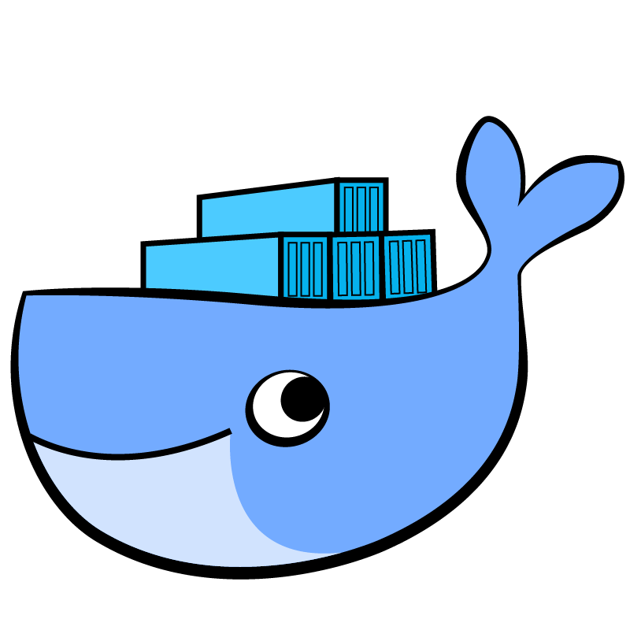


Image Distribution
Containers
fat container
DC
datacenter
Demonset
deploy/upgrade
Notes:
Fat Container. Assimilation. 5GB for a hadoop base image. 3GB for a ubuntu base image.
Point of Presence, far from datacenter. Across the world.
Efficiency. 5K kubernetes cluster, deploy a new daemonset, or upgrade with a new version.
Docker image spec is designed for distribution efficiency since layers can be reused.
When you pull an image, the base of it may already present on the machine
Or on other machines.
Fat Containers: Big images.
PoP: Far from data center
Daemonset Deployment: Linear to cluster size.

Slide 4




File Distribution
OS
images
Runtime
jvm
docker
..
Application
.jar
npm modules
plugins
..
Configuration
indexes
training model
..
Notes:
Ground up:
OS installation, TFTP server for baremetal provisioning, Glance for openstack VM image.
Package Installation: debian, rpm
Application Installation: npm modules, java web archive
Configurations: Training Model, Indexes.
TODO: Add soma images on both left and right. Adjust the color
Operating system: BM provisioning, VM provisioning, TFTP server.
Packages: Runtimes, Monitoring agents, Security.
Application: Executables, Nodejs modules, JAR, Shared libraries.
Application Data: Indexes, Training Model

Slide 5

Distribution Flow
?
Client
curl, http client
ipip dsr, l2 dsr
Load Balancer
hlb, slb
redirection, temp url
Service
registry, maven, glance
cache servers
Storage
object storage, block storage
Notes:
This is simple, traditional
Single endpoint of server, all traffic goes through the vip.
Well, you can add DSR configuration on the load balancer if you want to get higher throughput.

Slide 6
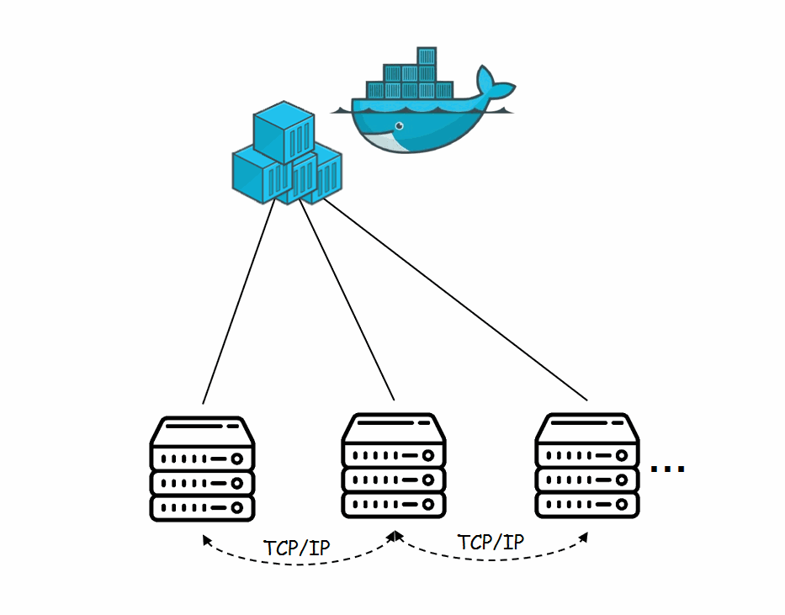
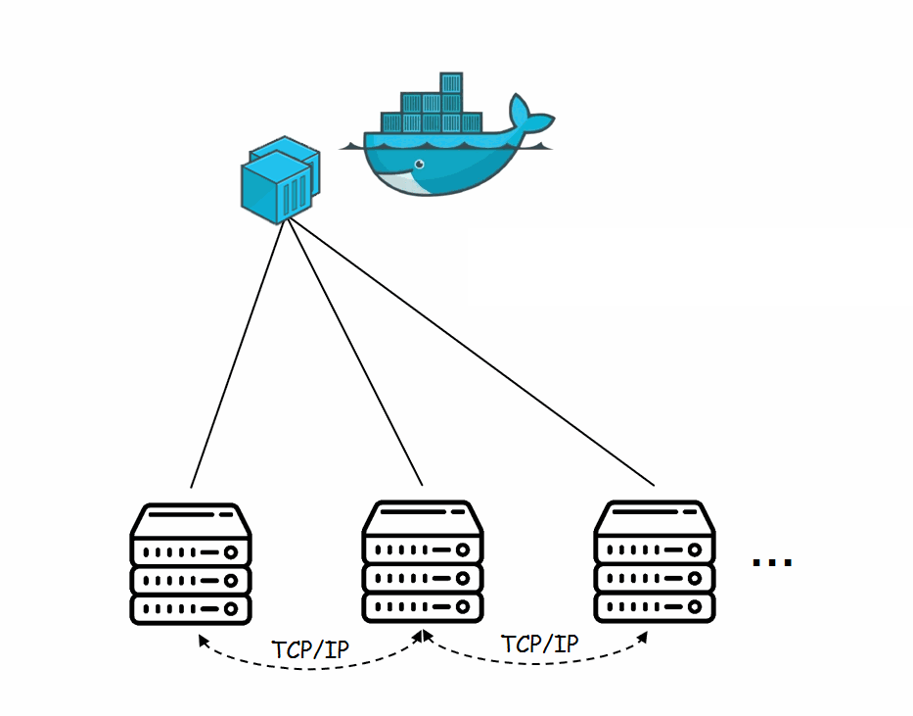



P2P
images credits to https://mp.weixin.qq.com/s/dGwhhg8FzOxUVmvlyWkN7g
Notes:
Solved problem:
Bittorrent, IPFS?
Review different Kinds of P2P network: Linear network; Star Network; Supervised; Unsupervised.
Determined: The topology is determined, which connect to which
Random: The upstream and downstream is not determined, instead it adjusts automatically
Supervised: Tracker like, a central node manages all the distributed hash table
Unsupervised: Each peer learn from each other. (what eBay uses)

Slide 7
Dragonfly
download
source
supernode
update pieces
pieces of task
register as peer
create task
https://<host>/<resource>
dfget
dfget
download

Slide 8
SuperNode
API
peers
tasks
pieces
Scheduling
select peers
Seeding
initial seeding
source
download
supernode
update pieces
pieces of task
create task
register as peer
https://<host>/<resource>
dfget
dfget
download

Slide 9
DFGet
CLI
Rate Limit
Per Task
Per Host
Checksum
integrity check
Seeding
source
download
supernode
update pieces
pieces of task
create task
register as peer
https://<host>/<resource>
dfget
dfget
download

Slide 10
OCI Images
Docker Registry Mirrors
--registry-mirror=https://<your awesome mirror>
Containerd CRI Registry Mirrors
[plugins.cri.registry.mirrors]
[plugins.cri.registry.mirrors."docker.io"]
endpoint = ["https://registry-1.docker.io"]
[plugins.cri.registry.mirrors."test.secure-registry.io"]
endpoint = ["https://HostIP1:Port1"]
[plugins.cri.registry.mirrors."test.insecure-registry.io"]
endpoint = ["http://HostIP2:Port2"]
Add redirection in your registry
Notes:
You can only control the clients where you can change the code. but that’s not always the case. Specifically for image distribution, we need to deal with Docker.
Talk about the registry API specification
/v2/
Authentication according to WWW-Authenticate challenge
/v2/<name>/manifests/<tag> which gives you a image manifest json.
/v2/<name>/blobs/<digest> read the layer data
Extracting and verification.

Slide 11
DFDaemon
Reverse Proxy
reverseProxy := httputil.NewSingleHostReverseProxy(target)
reverseProxy.Transport = NewDFRoundTripper(reg.TLSConfig())
reverseProxy.ServeHTTP(w, r)
Delegate to dfget
func RoundTrip(req *http.Request) (*http.Response, error) {
dstPath, err := rt.DFGetter.Download(req)
...
fileReq, err := http.NewRequest("GET", "file:///"+dstPath, nil)
rt.RoundTripper.RoundTrip(fileReq)
}
dfget
dfdaemon
docker

Slide 12
HOW
How does Dragonfly participate in pulling images?

Slide 13
What is an Image
Manifest: Image manifests describe the various constituents of a docker image. It can be serialized to JSON format.
Layer: Layers are stored in the blob portion of the registry, keyed by digest. Pulling a layer is carried out by a standard http request.
The process of pulling an image centers around retrieving these two components.

Slide 14
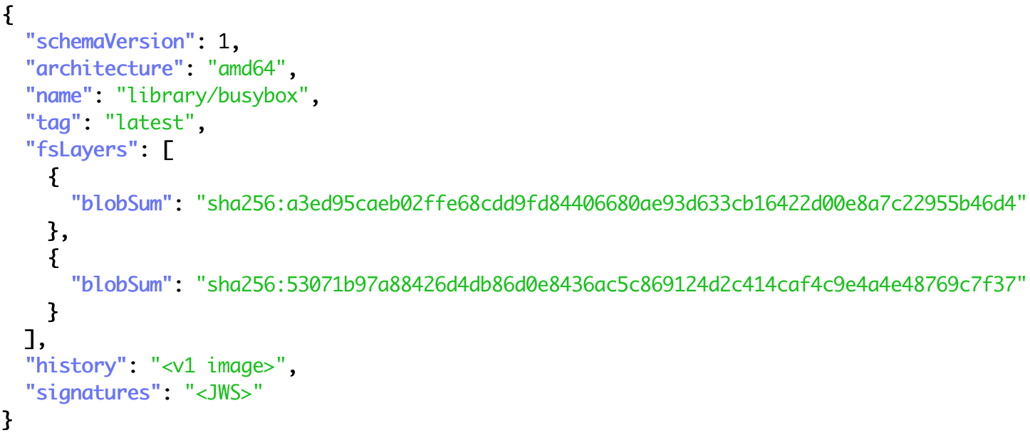
Pulling An Image Manifest
GET /v2/<name>/manifests/<reference>
https://index.docker.io/v2/library/busybox/manifests/latest

Slide 15
Pulling An Image Layer
GET /v2/<name>/blobs/<digest>
https://index.docker.io
/v2/library/busybox/blobs/sha256:a3ed95caeb02ffe68cdd9fd84406680ae93d633cb16422d00e8a7c22955b46d4
HTTP/1.1 307 Temporary Redirect
Content-Type: text/html; charset=utf-8
Docker-Distribution-Api-Version: registry/2.0
Location: https://production.cloudflare.docker.com/registry-v2/docker/registry/v2/blobs/sha256/a3/a3ed95caeb02ffe68cdd9fd84406680ae93d633cb16422d00e8a7c22955b46d4/data?verify=1557992361-BQ1w7DnW3SIhRdZR1kaasx91GB8%3D
Date: Thu, 16 May 2019 06:49:21 GMT
Strict-Transport-Security: max-age=31536000
HTTP/2 200
date: Thu, 16 May 2019 06:51:27 GMT
content-type: application/octet-stream
content-length: 32
accept-ranges: bytes
etag: "54a01009f17bdb7ec1dd1cb427244304"
last-modified: Sat, 14 Nov 2015 09:09:44 GMT
…
…
…
server: cloudflare

Slide 16
Pulling An Image Layer
GET /v2/<name>/blobs/<digest>
https://registry.cn-hangzhou.aliyuncs.com
/v2/dragonflyoss/supernode/blobs/sha256:a3ed95caeb02ffe68cdd9fd84406680ae93d633cb16422d00e8a7c22955b46d4
HTTP/2 307
content-type: application/octet-stream
docker-distribution-api-version: registry/2.0
location: http://aliregistry.oss-cn-hangzhou.aliyuncs.com/docker/registry/v2/blobs/sha256/a3/a3ed95caeb02ffe68cdd9fd84406680ae93d633cb16422d00e8a7c22955b46d4/data?Expires=1557992474&OSSAccessKeyId=Ygxs2RciveEJoGFt&Signature=UDuwVj5utOIzCfPoMZtKKly0ngQ%3D
content-length: 0
date: Thu, 16 May 2019 07:21:14 GMT
HTTP/1.1 200 OK
Date: Thu, 16 May 2019 07:23:13 GMT
Content-Type: application/octet-stream
Content-Length: 32
Accept-Ranges: bytes
ETag: "54A01009F17BDB7EC1DD1CB427244304"
Last-Modified: Thu, 10 Sep 2015 13:10:49 GMT
…
...
…
Server: AliyunOSS

Slide 17
Pulling An Image Layer
GET /v2/<name>/blobs/<digest>
https://h3vtnoaa.mirror.aliyuncs.com
/v2/library/busybox/blobs/sha256:a3ed95caeb02ffe68cdd9fd84406680ae93d633cb16422d00e8a7c22955b46d4
HTTP/2 200
accept-ranges: bytes
cache-control: max-age=31536000
content-type: application/octet-stream
docker-content-digest: sha256:a3ed95caeb02ffe68cdd9fd84406680ae93d633cb16422d00e8a7c22955b46d4
docker-distribution-api-version: registry/2.0
etag: "sha256:a3ed95caeb02ffe68cdd9fd84406680ae93d633cb16422d00e8a7c22955b46d4"
content-length: 32
date: Thu, 16 May 2019 07:12:56 GMT

Slide 18
Pulling An Image by Dragonfly
Individual Layer Files

Slide 19
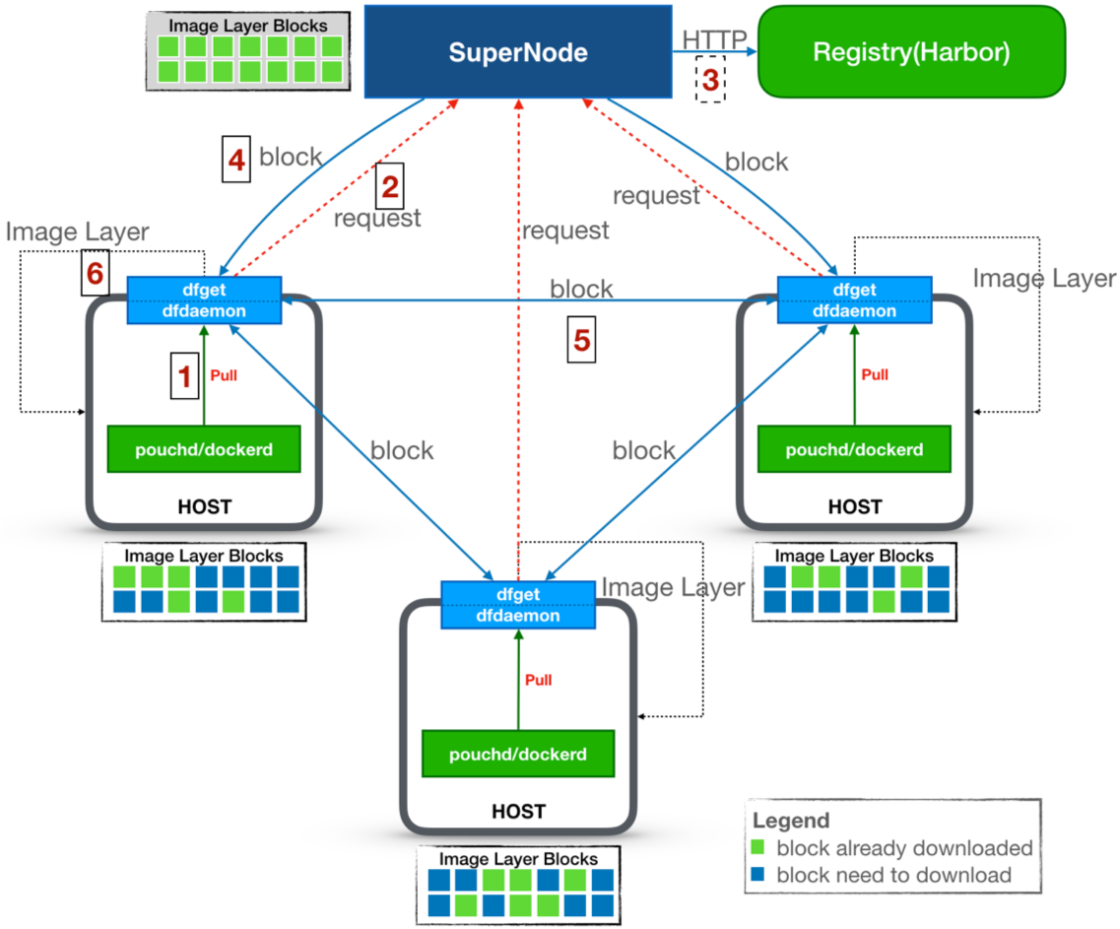
Pulling An Image by Dragonfly
Pull image from node proxy(dfdaemon)
Send pulling requests to SuperNode
Cache image layer from Registry if non-exist
Reply to node peers which have blocks
Transport blocks among all peers
Finish whole pulling when all blocks downloaded

Slide 20
DEMO
Deployment of Dragonfly
Usage of Dragonfly
download a file using dfget directly
download a file through proxy
pull an image through registry-mirror
pull an image through HTTP_PROXY
pull an image through HTTPS_PROXY

Slide 21
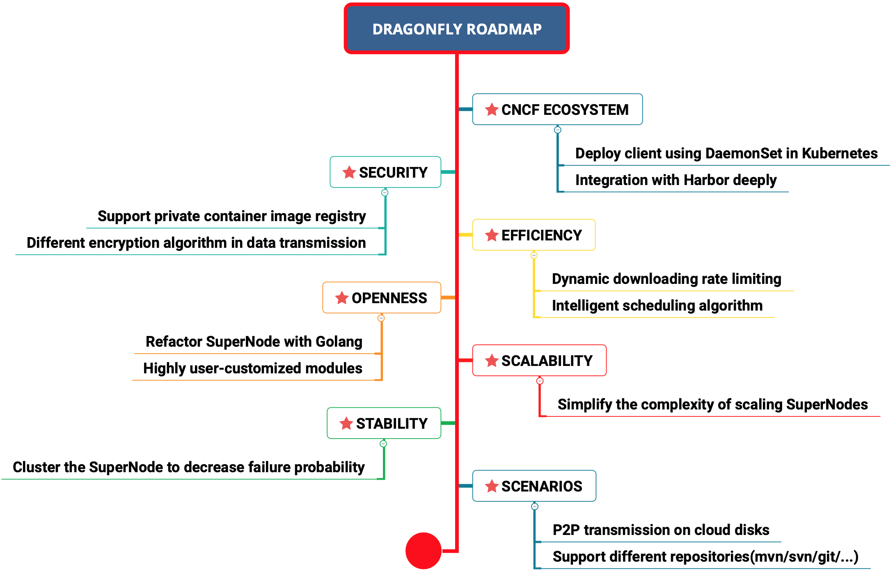
ROADMAP

Slide 22
Q&A
Q&A

Slide 23
THANKS

